Slide 1
A Section 9: Support Vector Machines Prepared & Presented by Will Claybaugh

Slide 2
What do you get when you cross an elephant and a rhino?
Q: What does logistic regression think of LDA/QDA?

Slide 3
What do you get when you cross an elephant and a rhino?
Q: What does logistic regression think of LDA/QDA?

Slide 4
A: You’re modelling too much
LDA/QDA tell the complete story of how the data came to be
Correspondingly, it makes heavy assumptions, and much can go wrong
Logistic doesn’t care how the X data came to be, it only tells the story of the Y data
Since there are fewer assumptions, the math is more advanced and the method is slower

Slide 5
Anyone take the old SATs?
SVM:Logistic Regression::Logistic Regression:QDA

Slide 6
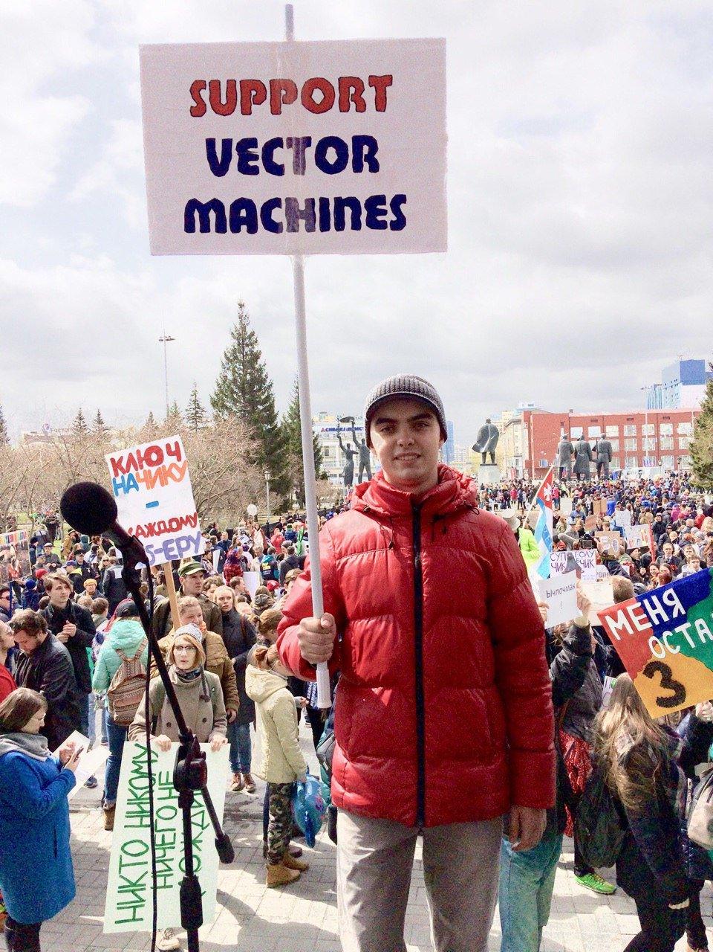
Less is More
SVMs
Only predict the final class, not the probability of each class
Make no assumptions about the data
Still work well with large numbers of features

Slide 7
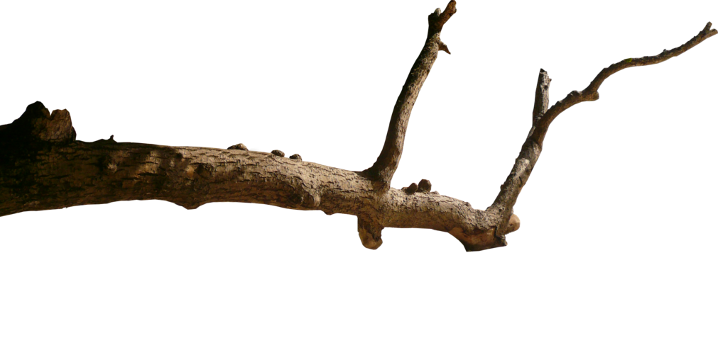
Our Path
I: Get comfy with the key expressions and concepts
Bundles, signed distance, class-based distance
II: Extract the highlights of SVMs from the loss function
Only certain observations matter; effects of the C parameter
III: Derivation of the primal and dual problems, fulfilling the promises from Part II
Lagrangian, Piramal/Dual games, KKT conditions as souped-up “derivative=0”
IV: Interpret the dual problem and see SVMs in a new way
SVMs can be seen as an advanced neighbors-style algorithm

Slide 8
review
Part I
P

Slide 9
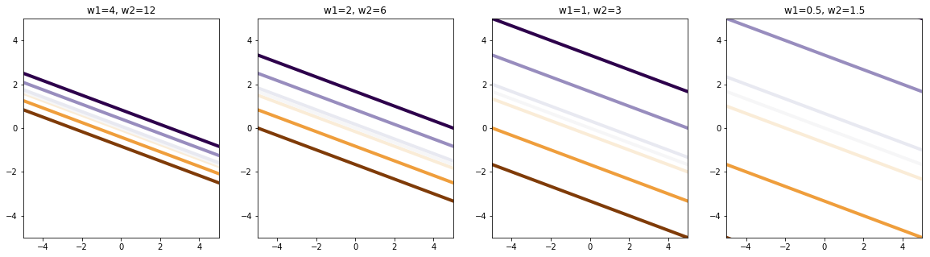
Act I: Setting
Like Logistic regression, SVMs set three parameters: a weight on each feature (w1 and w2) and an intercept (b)
This is MORE than we need to define a line
So what are we really defining?

Slide 10
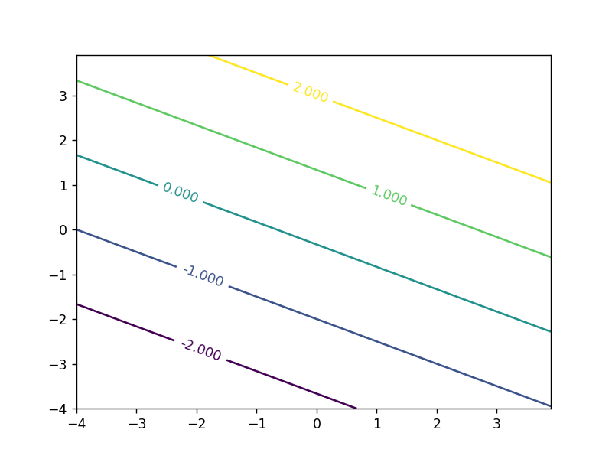
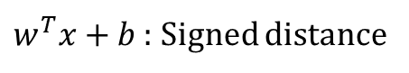
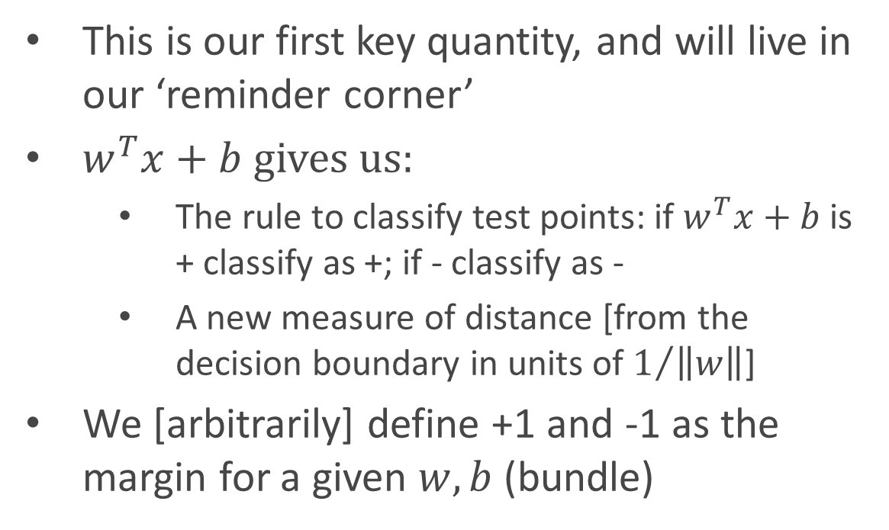
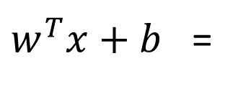
Key Concept #1
$w^{T}x+b$ : Signed distance
Via $w^{T}x+b$, $w$ and $b$ define an output at each point of input space
This is our first key quantity, and will live in our ‘reminder corner’
$w^{T}x+b$ gives us:
The rule to classify test points: if $w^{T}x+b$is + classify as +; if - classify as -
A new measure of distance [from the decision boundary in units of $1/{\left\|w\right\|}$]
We [arbitrarily] define +1 and -1 as the margin for a given $w,b$ (bundle)
$w^{T}x+b$ =

Slide 11
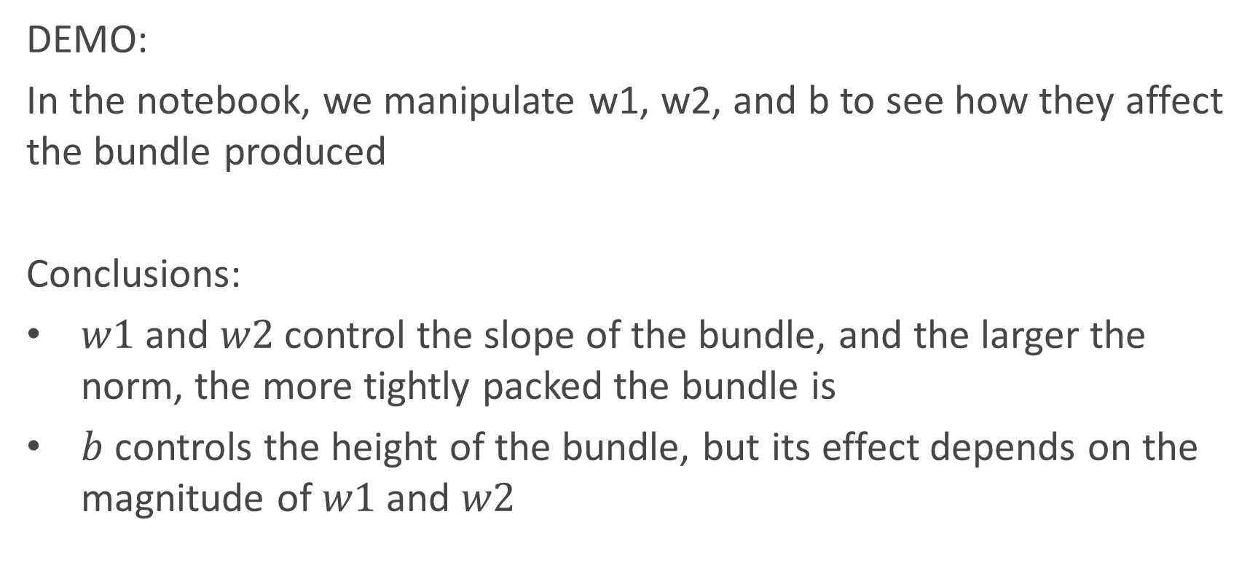
Live Demo
$w^{T}x+b$ : Signed distance
DEMO:
In the notebook, we manipulate w1, w2, and b to see how they affect the bundle produced
Conclusions:
$w1$ and $w2$ control the slope of the bundle, and the larger the norm, the more tightly packed the bundle is
$b$ controls the height of the bundle, but its effect depends on the magnitude of $w1$ and $w2$

Slide 12
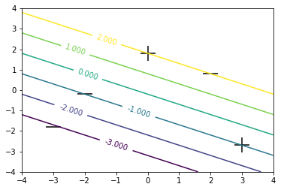
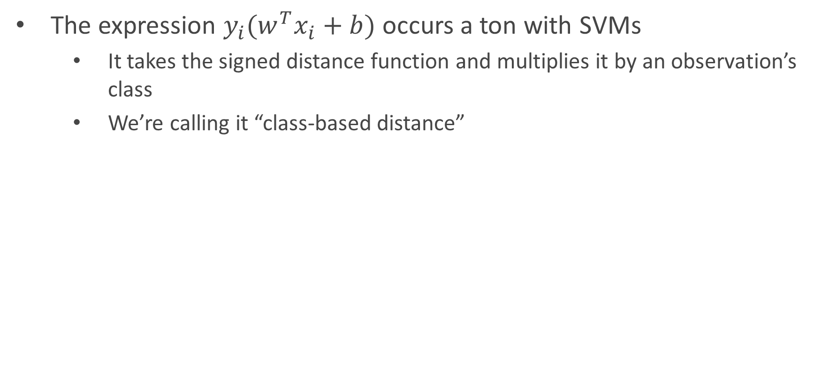
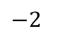
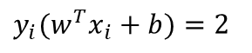
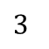
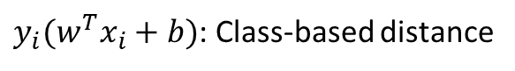
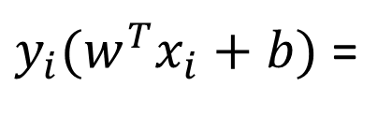
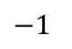
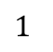
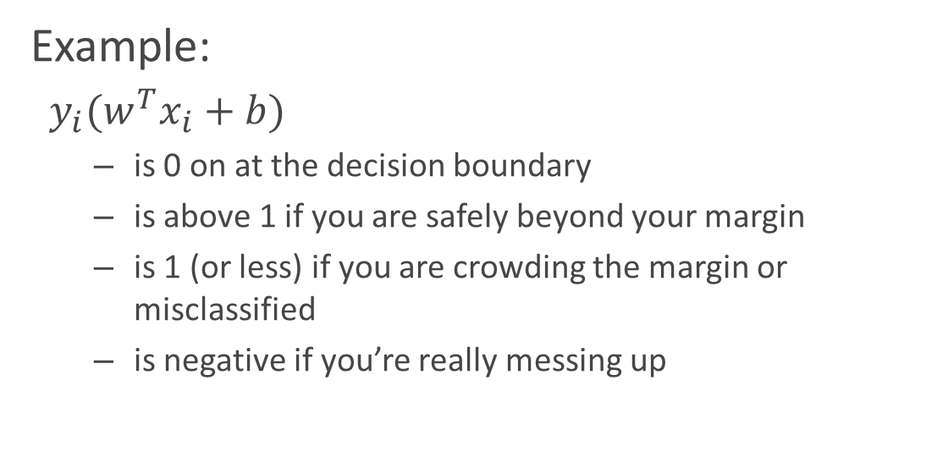
Key Concept #2
$w^{T}x+b$ : Signed distance
$y_{i}(w^{T}x_{i}+b)$: Class-based distance
The expression $y_{i}(w^{T}x_{i}+b)$ occurs a ton with SVMs
It takes the signed distance function and multiplies it by an observation’s class
We’re calling it “class-based distance”
$y_{i}(w^{T}x_{i}+b)$ =
Example:
$y_{i}(w^{T}x_{i}+b)$
is 0 on at the decision boundary
is above 1 if you are safely beyond your margin
is 1 (or less) if you are crowding the margin or misclassified
is negative if you’re really messing up
$y_{i}(w^{T}x_{i}+b)=2$
$−2$
$1$
$3$
$−1$

Slide 13
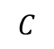
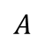
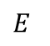
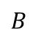
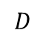
$w^{T}x+b$ : Signed distance
$y_{i}(w^{T}x_{i}+b)$: Class-based distance
A table of the key quantities at each point
Point | Class | Signed Distance | Class-based distance | Loss
A | - | -3 | 3 | None
B | - | -1 | 1 | Marginal
C | + | 2 | 2 | None
D | - | 2 | -2 | Misclass
E | + | -1 | -1 | Misclass
$$C$$
$$D$$
$B$
$A$
$E$

Slide 14
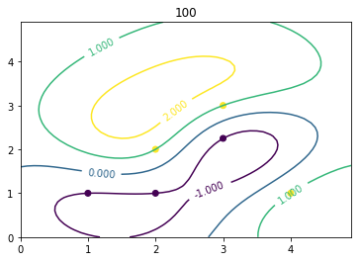
Kernels
$w^{T}x+b$ : Signed distance
$y_{i}(w^{T}x_{i}+b)$: Class-based distance
The same ‘signed distance’ concepts apply to kernels, although:
The lines get wavy
The way we measure distance is less clear
Later on, we’ll learn
What kind distance is used for kernels
Standard distance isn’t what you think

Slide 15
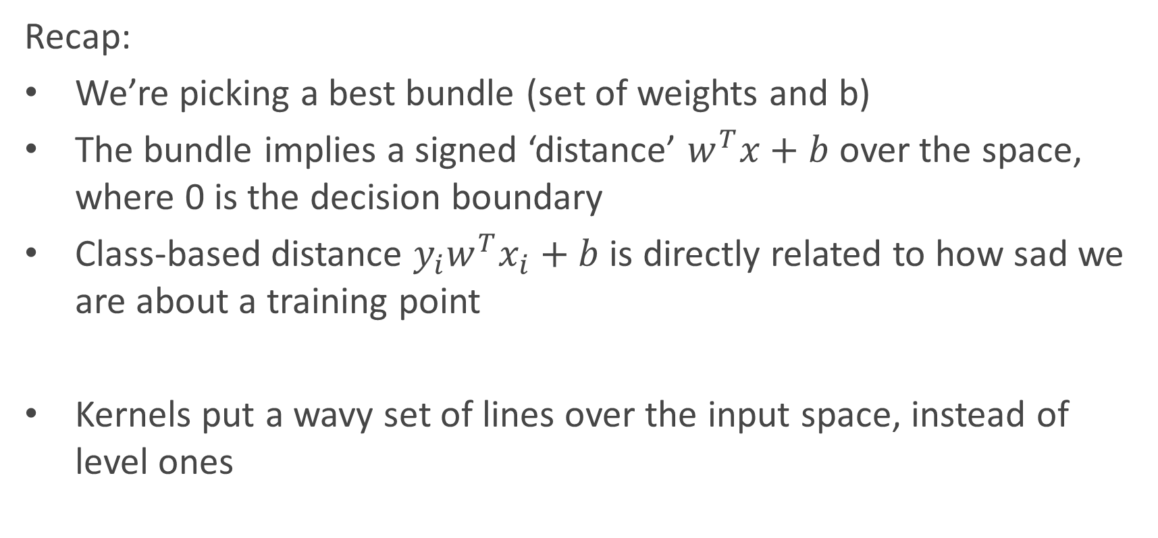
Recap
$w^{T}x+b$ : Signed distance
$y_{i}(w^{T}x_{i}+b)$: Class-based distance
Recap:
We’re picking a best bundle (set of weights and b)
The bundle implies a signed ‘distance’ $w^{T}x+b$ over the space, where 0 is the decision boundary
Class-based distance $y_{i}w^{T}x_{i}+b$ is directly related to how sad we are about a training point
Kernels put a wavy set of lines over the input space, instead of level ones

Slide 16
Loss Functions
Part II

Slide 17
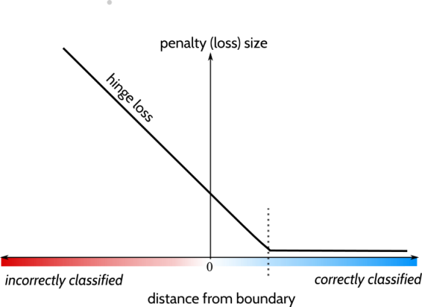
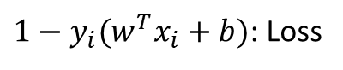
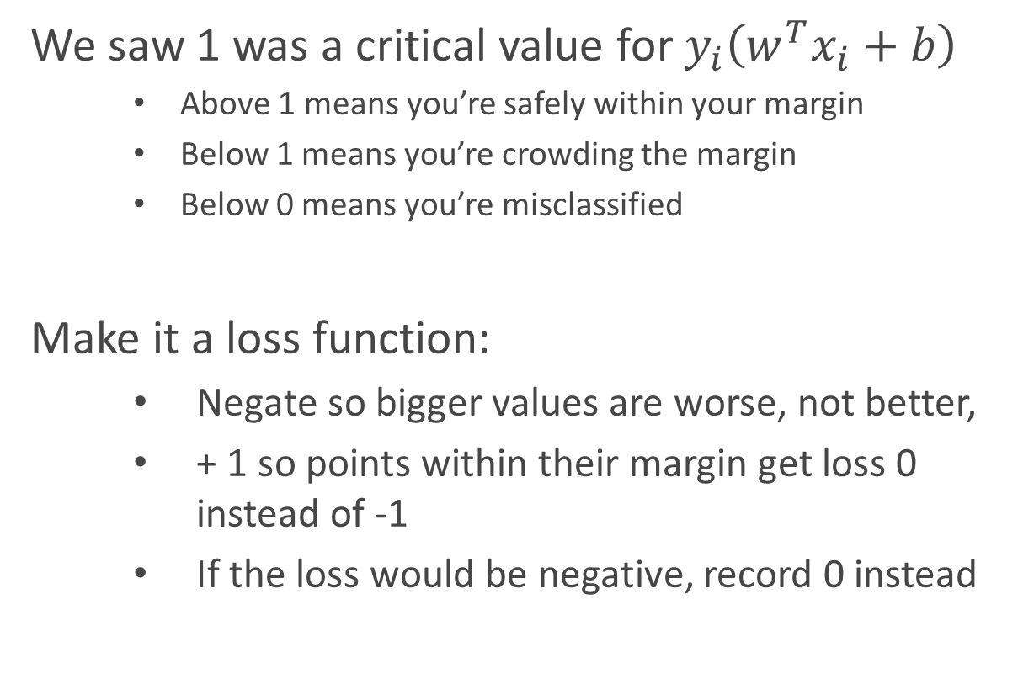
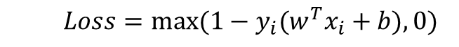
Hinge Loss
$w^{T}x+b$ : Signed distance
$1−y_{i}(w^{T}x_{i}+b)$: Loss
$y_{i}(w^{T}x_{i}+b)$: Class-based distance
We saw 1 was a critical value for $y_{i}\left(w^{T}x_{i}+b\right)$
Above 1 means you’re safely within your margin
Below 1 means you’re crowding the margin
Below 0 means you’re misclassified
Make it a loss function:
Negate so bigger values are worse, not better,
+ 1 so points within their margin get loss 0 instead of -1
If the loss would be negative, record 0 instead
$$Loss=max⁡(1−y_{i}(w^{T}x_{i}+b),0)$$

Slide 18
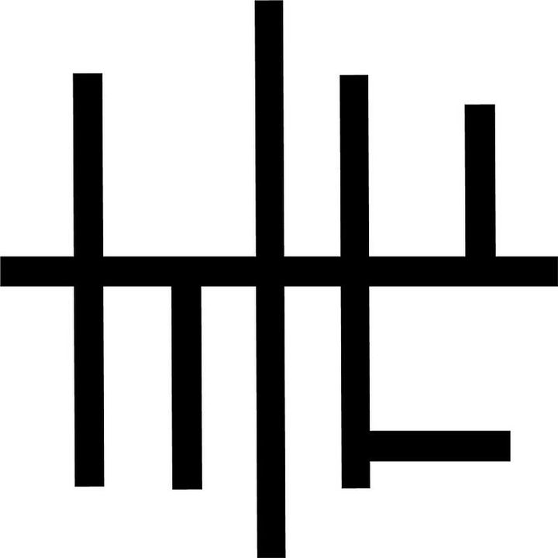
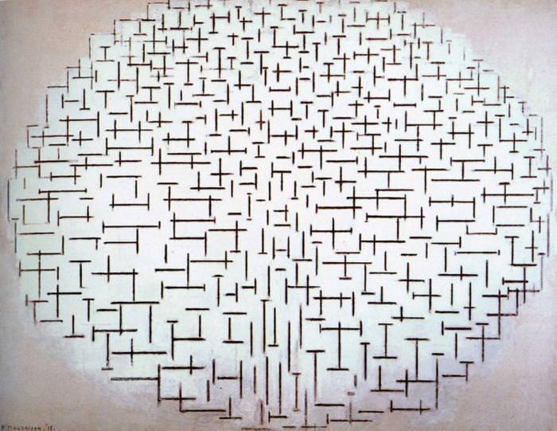
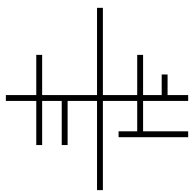
Loss
$w^{T}x+b$ : Signed distance
$1−y_{i}(w^{T}x_{i}+b)$: Loss
Which do you like best?

Slide 19
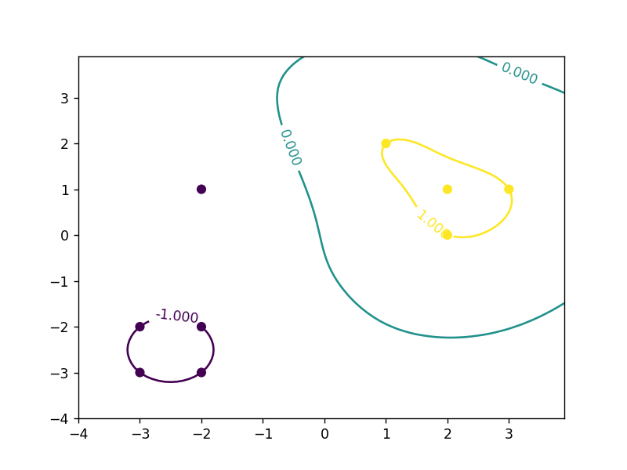
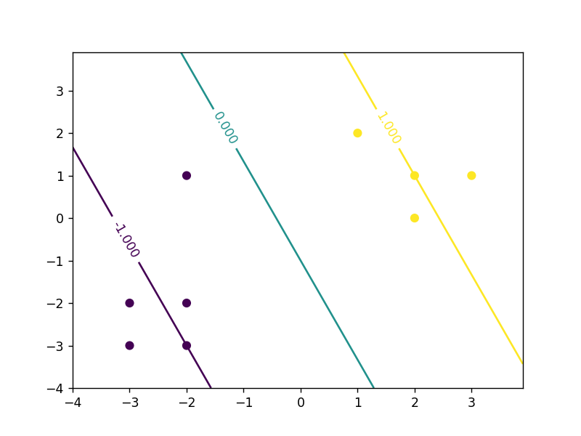
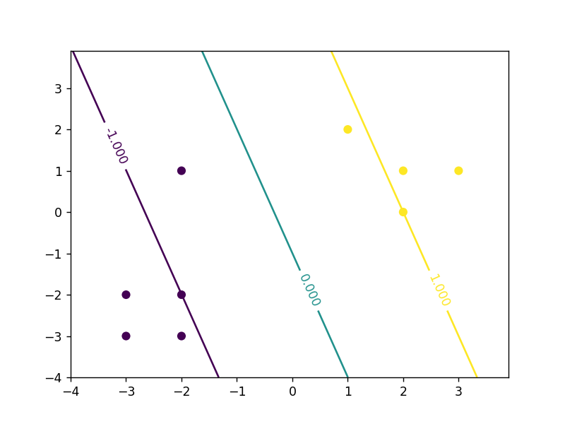
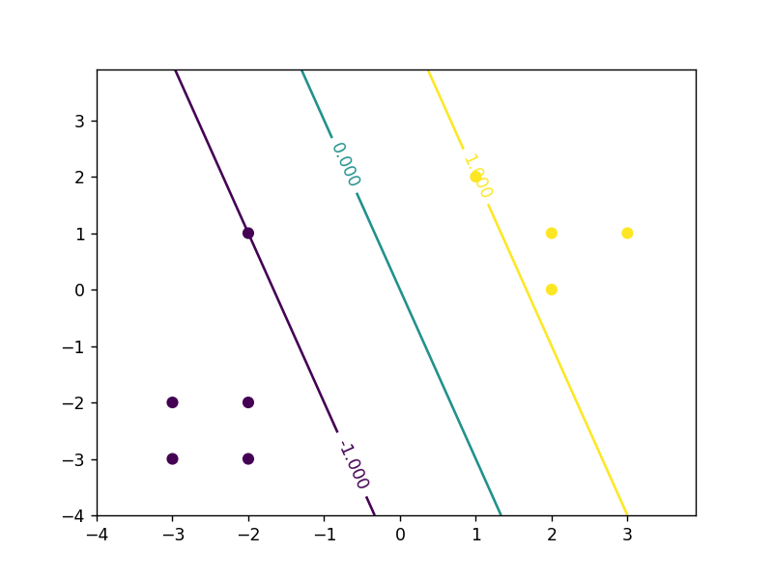
Act II: Loss
$w^{T}x+b$ : Signed distance
$1−y_{i}(w^{T}x_{i}+b)$: Loss
Which do you like best?

Slide 20
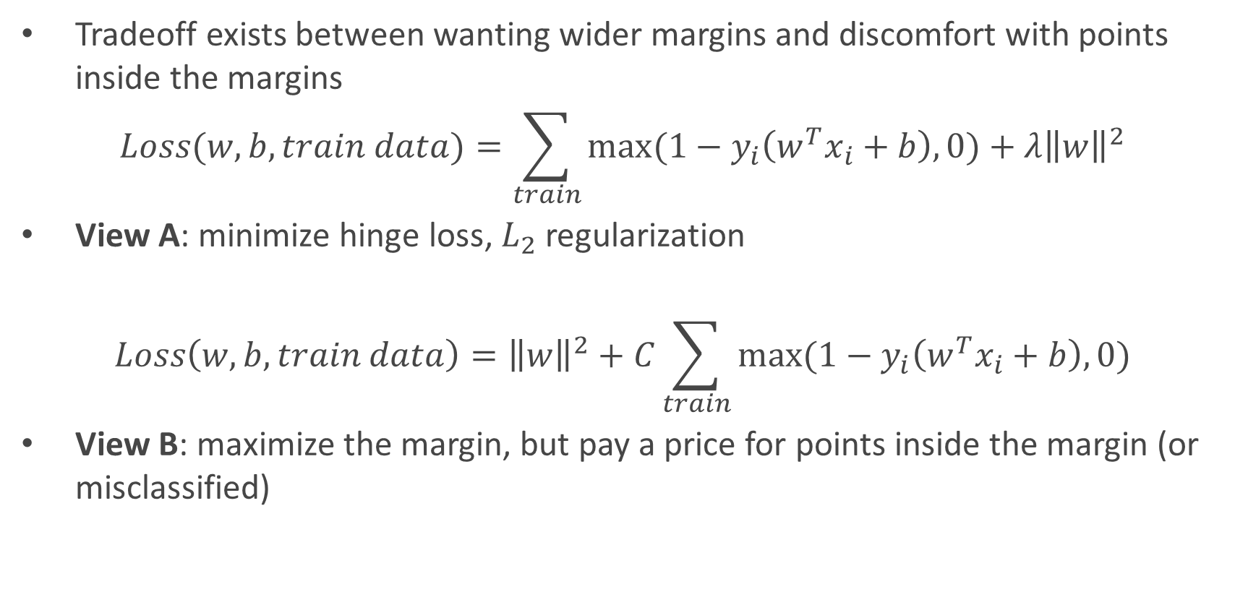
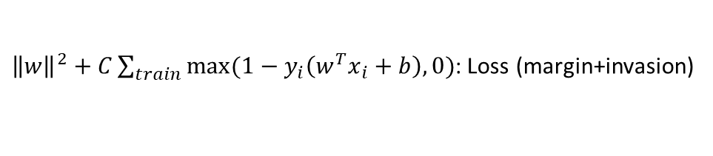
The Loss Function
$w^{T}x+b$ : Signed distance
${\left\|w\right\|}^{2}+C\sum_{train}{max⁡(1−y_{i}\left(w^{T}x_{i}+b\right),0)}$: Loss (margin+invasion)
Tradeoff exists between wanting wider margins and discomfort with points inside the margins
$$Loss(w,b, train data)=\sum_{train}{max⁡(1−y_{i}\left(w^{T}x_{i}+b\right),0)}+λ{\left\|w\right\|}^{2}$$
View A: minimize hinge loss, $L_{2}$ regularization
$$Loss\left(w,b, train data\right)={\left\|w\right\|}^{2}+C\sum_{train}{max⁡(1−y_{i}\left(w^{T}x_{i}+b\right),0)}$$
View B: maximize the margin, but pay a price for points inside the margin (or misclassified)
Notes:
Comment: the point of the seperable case is that the invasion loss can be made zero and we’re just arguing about norms, and the best we can do (0 loss) is to put 1 and -1 on each class. Regularization can help even in the seperable case, since full separation is chasing minimum training loss at the expense of generalization.

Slide 21
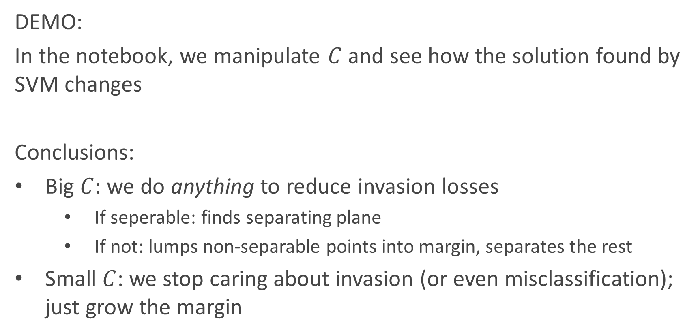
Live Demo
$w^{T}x+b$ : Signed distance
${\left\|w\right\|}^{2}+C\sum_{train}{max⁡(1−y_{i}\left(w^{T}x_{i}+b\right),0)}$: Loss (margin+invasion)
DEMO:
In the notebook, we manipulate $C$ and see how the solution found by SVM changes
Conclusions:
Big $C$: we do anything to reduce invasion losses
If seperable: finds separating plane
If not: lumps non-separable points into margin, separates the rest
Small $C$: we stop caring about invasion (or even misclassification); just grow the margin
Notes:
Ask what will happen if we give a non-seperable problem and jack C way up

Slide 22
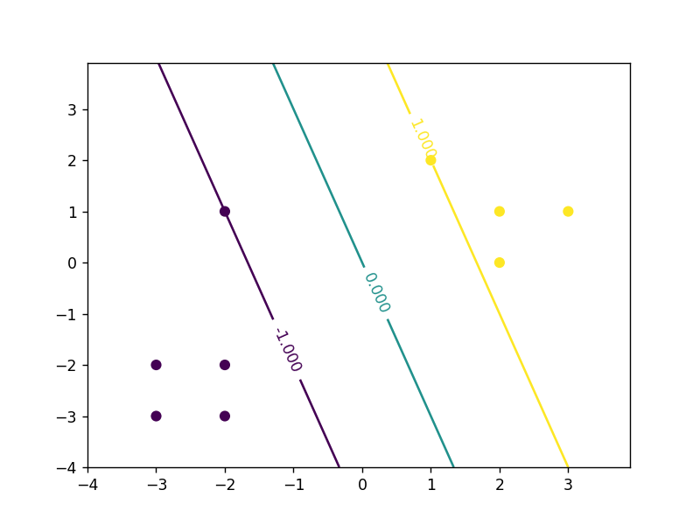
Observations
$w^{T}x+b$ : Signed distance
${\left\|w\right\|}^{2}+C\sum_{train}{max⁡(1−y_{i}\left(w^{T}x_{i}+b\right),0)}$: Loss (margin+invasion)
Observations from SVM loss:
Hinge loss zero for most points
most points are behind the margin
Moving/deleting these points wouldn’t change the solution
The outcome for a test point only depends on a handful of training points
Should be able to write output value as combination of (-2,1) and (1,2)
Key question: HOW can we determine a test point’s class using the few important training points?
Leads to re-casting as a fancified neighbors algorithm

Slide 23
What to watch for
$w^{T}x+b$ : Signed distance
${\left\|w\right\|}^{2}+C\sum_{train}{max⁡(1−y_{i}\left(w^{T}x_{i}+b\right),0)}$: Loss (margin+invasion)
Our reward for sitting through the math:
A recipe for the most important training points
A way to make decisions while throwing out most of the training data
A new and more powerful view of what SVMs do
Like studying linear regression’s loss minimization via calculus, but with a harder target and more advanced math

Slide 24
Math
Part III
Ideas: http://cs229.stanford.edu/notes/cs229-notes3.pdf Soft-Margin derivation: http://www.ccs.neu.edu/home/vip/teach/MLcourse/6_SVM_kernels/lecture_notes/svm/svm.pdf

Slide 25
Author’s Proof
$w^{T}x+b$ : Signed distance
${\left\|w\right\|}^{2}+C\sum_{train}{max⁡(1−y_{i}\left(w^{T}x_{i}+b\right),0)}$: Loss (margin+invasion)
Outline proof steps
Re-cast the loss function as a convex optimization
Re-write the one-player game into a two-player game (Primal)
Rewrite the two-player game into an equivalent game with opposite turn order (Dual)
Observe that assigning (mostly-zero) importance scores to each training point is equivalent to solving the original optimization (KKT)
Observe that our original SVM formulation was using a very counter-intuitive definition of distance, and we can do better

Slide 26
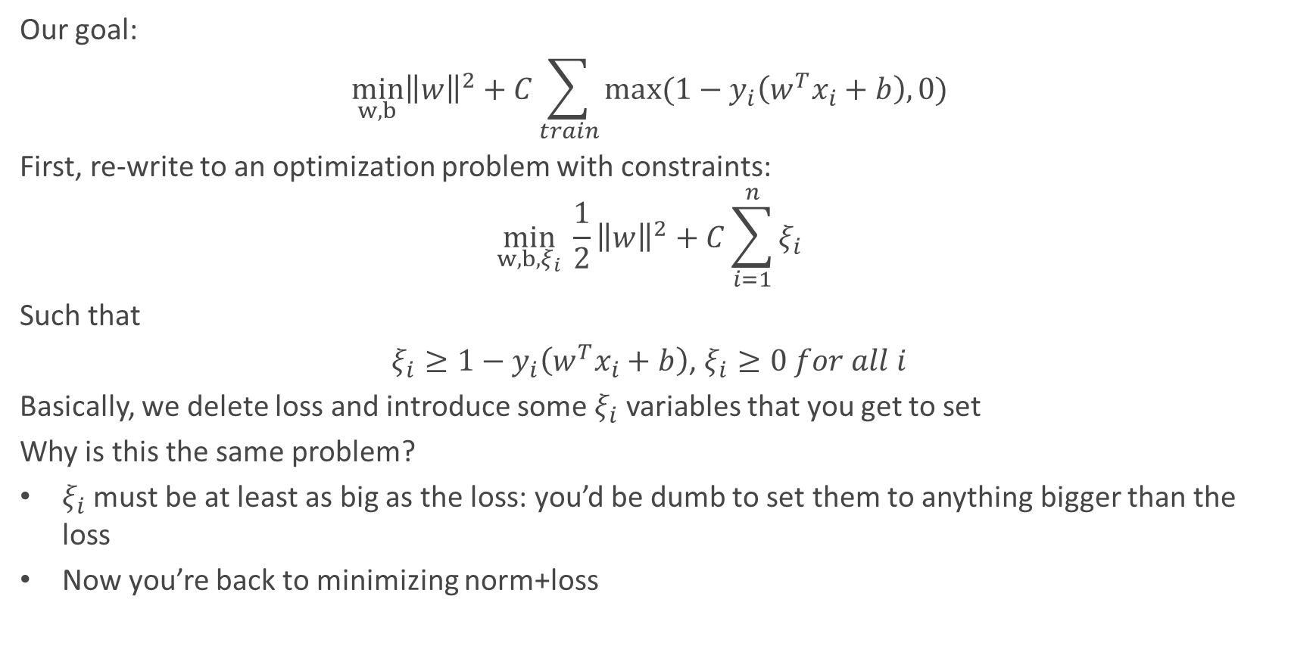
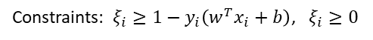
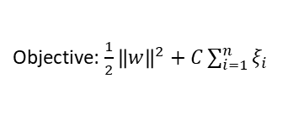
Optimization
$w^{T}x+b$ : Signed distance
Objective: $\frac{1}{2}{\left\|w\right\|}^{2}+C\sum_{i=1}^{n}{ξ_{i}}$
${\left\|w\right\|}^{2}+C\sum_{train}{max⁡(1−y_{i}\left(w^{T}x_{i}+b\right),0)}$: Loss (margin+invasion)
Constraints: $ξ_{i}≥1−y_{i}\left(w^{T}x_{i}+b\right)$, $ξ_{i}≥0$
Our goal:
$$\min_{w,b}{\left\|w\right\|}^{2}+C\sum_{train}{max⁡(1−y_{i}\left(w^{T}x_{i}+b\right),0)}$$
First, re-write to an optimization problem with constraints:
$$\min_{w,b,ξ_{i}} \frac{1}{2}{\left\|w\right\|}^{2}+C\sum_{i=1}^{n}{ξ_{i}}$$
Such that
$ξ_{i}≥1−y_{i}\left(w^{T}x_{i}+b\right)$, $ξ_{i}≥0 for all i$
Basically, we delete loss and introduce some $ξ_{i}$ variables that you get to set
Why is this the same problem?
$ξ_{i}$ must be at least as big as the loss: you’d be dumb to set them to anything bigger than the loss
Now you’re back to minimizing norm+loss
Notes:
Important choice: minimize quadratic st affine, other way could be more complex (but interesting).
The optimization view definitely came first

Slide 27

Yeah, ‘hypothetically’…
$w^{T}x+b$ : Signed distance
Objective: $\frac{1}{2}{\left\|w\right\|}^{2}+C\sum_{i=1}^{n}{ξ_{i}}$
Constraints: $ξ_{i}≥1−y_{i}\left(w^{T}x_{i}+b\right)$, $ξ_{i}≥0$
You’re trying to plan your week
You have to choose how much time you allocate to study, work, etc.
There are hard constraints
What if the constraints were flexible?
You’d know what the cost of being each late day is
And how about a reward for getting work done early!
Max 20 hours of work-study
CS109 maximum 1 day late
CS207 due by Thursday
Minimum 4 hours of sleep
(Per week)
No asec OH on Wednesday
Job interview Thursday
Project meeting by Monday
Meal budget: $20
Call your mom
Brush your teeth
TODO
TODO

Slide 28
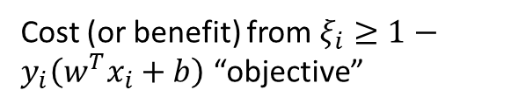
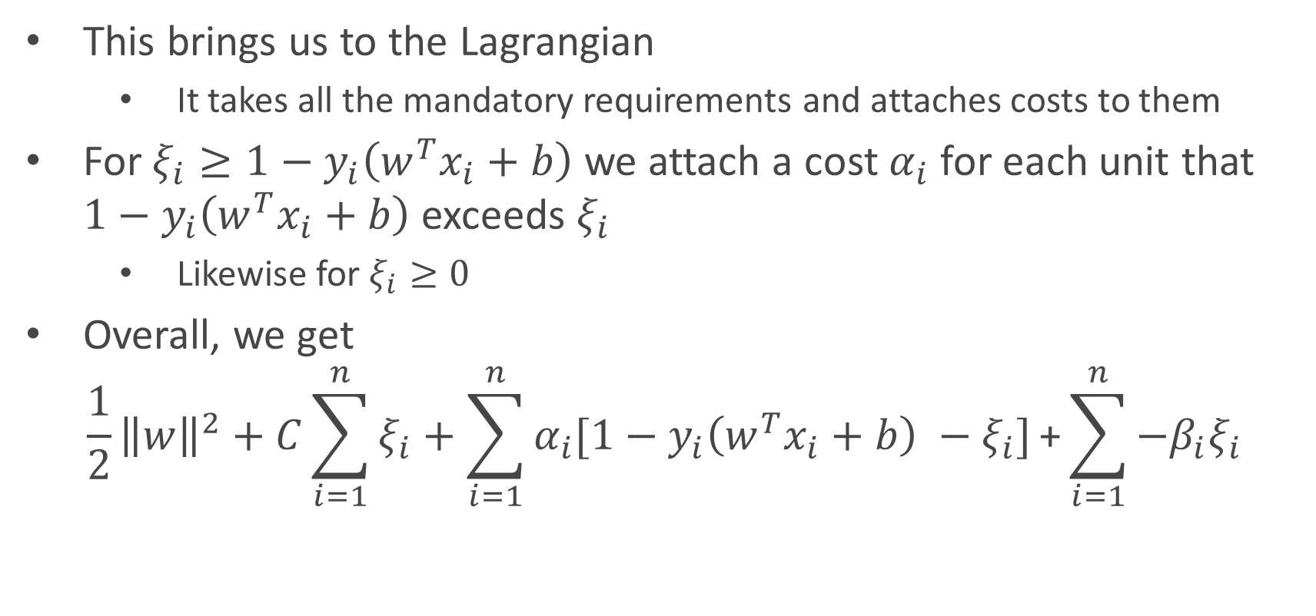
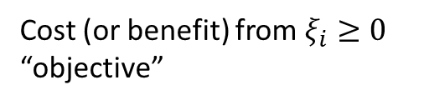
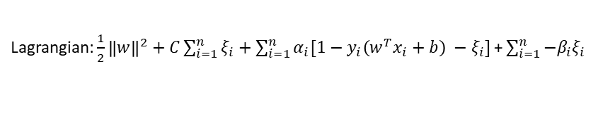
Lagrange Multipliers
$w^{T}x+b$ : Signed distance
Objective: $\frac{1}{2}{\left\|w\right\|}^{2}+C\sum_{i=1}^{n}{ξ_{i}}$
Lagrangian: $\frac{1}{2}{\left\|w\right\|}^{2}+C\sum_{i=1}^{n}{ξ_{i}}+\sum_{i=1}^{n}{α_{i}[1−y_{i}\left(w^{T}x_{i}+b\right) −ξ_{i}]}\text{+}\sum_{i=1}^{n}{{−β}_{i}ξ_{i}}$
Constraints: $ξ_{i}≥1−y_{i}\left(w^{T}x_{i}+b\right)$, $ξ_{i}≥0$
This brings us to the Lagrangian
It takes all the mandatory requirements and attaches costs to them
For $ξ_{i}≥1−y_{i}\left(w^{T}x_{i}+b\right)$ we attach a cost $α_{i}$ for each unit that $1−y_{i}\left(w^{T}x_{i}+b\right)$ exceeds $ξ_{i}$
Likewise for $ξ_{i}≥0$
Overall, we get
$$\frac{1}{2}{\left\|w\right\|}^{2}+C\sum_{i=1}^{n}{ξ_{i}}+\sum_{i=1}^{n}{α_{i}[1−y_{i}\left(w^{T}x_{i}+b\right) −ξ_{i}]}\text{+}\sum_{i=1}^{n}{{−β}_{i}ξ_{i}}$$
Original objective
Cost (or benefit) from $ξ_{i}≥1−y_{i}\left(w^{T}x_{i}+b\right)$ “objective”
Cost (or benefit) from $ξ_{i}≥0$ “objective”

Slide 29

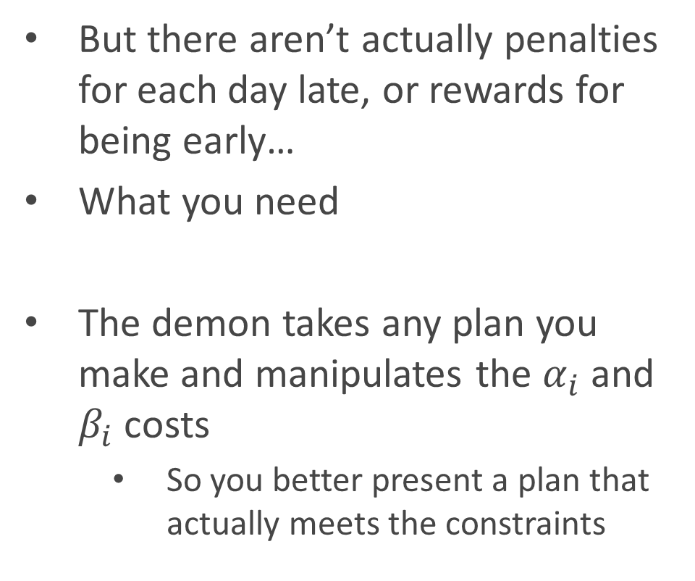
Doom
$w^{T}x+b$ : Signed distance
, Khazad
Lagrangian: $\frac{1}{2}{\left\|w\right\|}^{2}+C\sum_{i=1}^{n}{ξ_{i}}+\sum_{i=1}^{n}{α_{i}[1−y_{i}\left(w^{T}x_{i}+b\right) −ξ_{i}]}\text{+}\sum_{i=1}^{n}{{−β}_{i}ξ_{i}}$
But there aren’t actually penalties for each day late, or rewards for being early…
What you need
The demon takes any plan you make and manipulates the $α_{i}$ and $β_{i}$ costs
So you better present a plan that actually meets the constraints
is a demon
You shall not pass

Slide 30
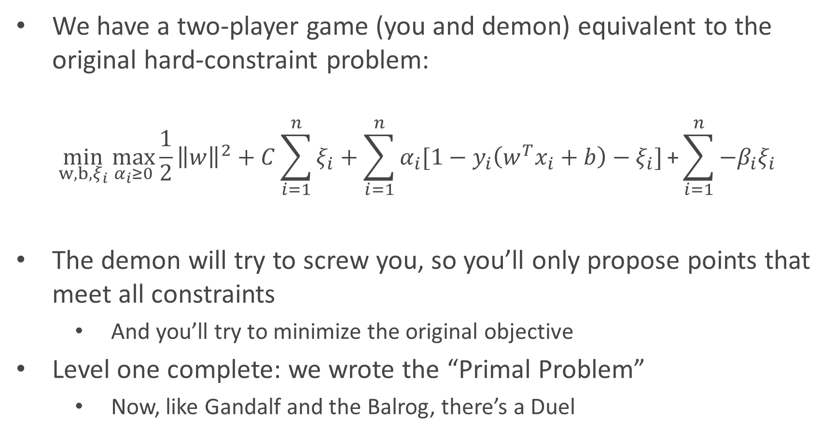
Primal scream
$w^{T}x+b$ : Signed distance
Lagrangian: $\frac{1}{2}{\left\|w\right\|}^{2}+C\sum_{i=1}^{n}{ξ_{i}}+\sum_{i=1}^{n}{α_{i}[1−y_{i}\left(w^{T}x_{i}+b\right) −ξ_{i}]}\text{+}\sum_{i=1}^{n}{{−β}_{i}ξ_{i}}$
We have a two-player game (you and demon) equivalent to the original hard-constraint problem:
$$\min_{w,b,ξ_{i}}\max_{α_{i}≥0}{\frac{1}{2}{\left\|w\right\|}^{2}+C\sum_{i=1}^{n}{ξ_{i}}+\sum_{i=1}^{n}{α_{i}[1−y_{i}\left(w^{T}x_{i}+b\right)−ξ_{i}]}\text{+}\sum_{i=1}^{n}{−β_{i}ξ_{i}}}$$
The demon will try to screw you, so you’ll only propose points that meet all constraints
And you’ll try to minimize the original objective
Level one complete: we wrote the “Primal Problem”
Now, like Gandalf and the Balrog, there’s a Duel
You choose the parameters
Then the demon chooses the costs
Notes:
This is exactly like not having a demon. We can think through the problem alone and try to solve it, or imagine a demon will charge us infinity dollars per violated constraint and try to solve in those conditions
Faccist to capitalist transition. Instead of demanding constraint obeying, we charge/reward for keeping them. The demon thing is only needed to stop non-solutions

Slide 31


$w^{T}x+b$ : Signed distance
Lagrangian: $\frac{1}{2}{\left\|w\right\|}^{2}+C\sum_{i=1}^{n}{ξ_{i}}+\sum_{i=1}^{n}{α_{i}[1−y_{i}\left(w^{T}x_{i}+b\right) −ξ_{i}]}\text{+}\sum_{i=1}^{n}{{−β}_{i}ξ_{i}}$
Still pondering how to set your schedule, an Econ 101 student walks by
“The free market solves everything”
“What about companies polluting?”
“Well, charge them for each ton of carbon they emit
If you get prices right, they’ll stop”
Could you set the costs/rewards yourself and let the free market minimize the objective?
Can you set costs that guide them to the same solution as the original?

Slide 32
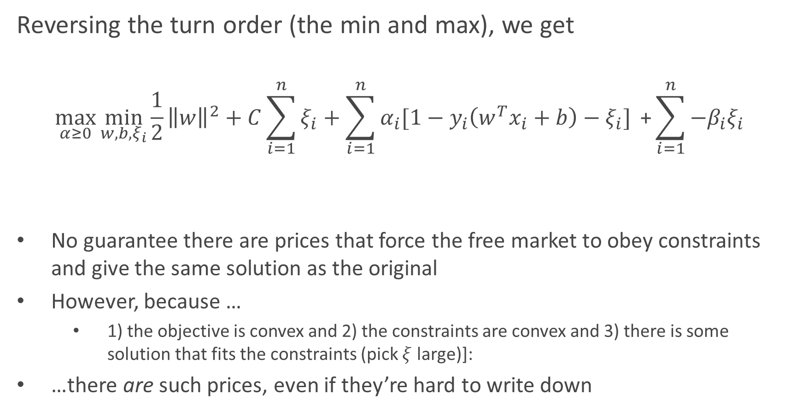
The Dual
$w^{T}x+b$ : Signed distance
Lagrangian: $\frac{1}{2}{\left\|w\right\|}^{2}+C\sum_{i=1}^{n}{ξ_{i}}+\sum_{i=1}^{n}{α_{i}[1−y_{i}\left(w^{T}x_{i}+b\right) −ξ_{i}]}\text{+}\sum_{i=1}^{n}{{−β}_{i}ξ_{i}}$
Reversing the turn order (the min and max), we get
$$\max_{α≥0}{\min_{w,b,ξ_{i}}{\frac{1}{2}{\left\|w\right\|}^{2}+C\sum_{i=1}^{n}{ξ_{i}}+\sum_{i=1}^{n}{α_{i}[1−y_{i}\left(w^{T}x_{i}+b\right)−ξ_{i}]} \text{+}\sum_{i=1}^{n}{{−β}_{i}ξ_{i}}}}$$
No guarantee there are prices that force the free market to obey constraints and give the same solution as the original
However, because …
1) the objective is convex and 2) the constraints are convex and 3) there is some solution that fits the constraints (pick $ξ$ large)]:
…there are such prices, even if they’re hard to write down
You set the costs/rewards
The market tries to minimize the objective, including any costs/subsidies you offer
Notes:
Just spending the minus sign

Slide 33

KKT Conditions
$w^{T}x+b$ : Signed distance
Lagrangian: $\frac{1}{2}{\left\|w\right\|}^{2}+C\sum_{i=1}^{n}{ξ_{i}}+\sum_{i=1}^{n}{α_{i}[1−y_{i}\left(w^{T}x_{i}+b\right) −ξ_{i}]}\text{+}\sum_{i=1}^{n}{{−β}_{i}ξ_{i}}$
IF the dual can be rigged to give the same solution as the original
THEN we get helpful facts about the solution called the KKT conditions
KKT can be used to check a candidate solution, or derive facts of the eventual solution
Derivative of Lagrangian (wrt any parameter) is 0
Derivative of Lagrangian (wrt cost of violating an equality) is 0
Constraint function $≤$ 0 (i.e. constraints are satisfied)
Cost*constraint = 0 (only binding constraints get non-zero costs)
Cost $≥$ 0 (costs are positive)

Slide 34
That was… mostly Econ
$w^{T}x+b$ : Signed distance
Lagrangian: $\frac{1}{2}{\left\|w\right\|}^{2}+C\sum_{i=1}^{n}{ξ_{i}}+\sum_{i=1}^{n}{α_{i}[1−y_{i}\left(w^{T}x_{i}+b\right) −ξ_{i}]}\text{+}\sum_{i=1}^{n}{{−β}_{i}ξ_{i}}$
Let’s recap
Wrote our optimization problem (minimize loss)
Massaged into a convex optimization problem
Horary for hinge loss and convexity
Applied Lagrangian to make progress on the constrained optimization
Costs instead of mandates, but a demon controls costs
Convexity let us study the dual problem instead
We control costs, but it’s not always possible to set them well
KKT gave us a bunch of useful properties we’re about to apply

Slide 35
That was… mostly Econ
$w^{T}x+b$ : Signed distance
Lagrangian: $\frac{1}{2}{\left\|w\right\|}^{2}+C\sum_{i=1}^{n}{ξ_{i}}+\sum_{i=1}^{n}{α_{i}[1−y_{i}\left(w^{T}x_{i}+b\right) −ξ_{i}]}\text{+}\sum_{i=1}^{n}{{−β}_{i}ξ_{i}}$
Let’s recap
Wrote our optimization problem (minimize loss)
Massaged into a convex optimization problem
Horary for hinge loss and convexity
Applied Lagrangian to make progress on the constrained optimization
Costs instead of mandates, but a demon controls costs
Convexity let us study the dual problem instead
We control costs, but it’s not always possible to set them well
KKT gave us a bunch of useful properties we’re about to apply

Slide 36
The Last Math
Part III: Part II

Slide 37


The first rule of KKT is
$w^{T}x+b$ : Signed distance
Lagrangian: $\frac{1}{2}{\left\|w\right\|}^{2}+C\sum_{i=1}^{n}{ξ_{i}}+\sum_{i=1}^{n}{α_{i}[1−y_{i}\left(w^{T}x_{i}+b\right) −ξ_{i}]}\text{+}\sum_{i=1}^{n}{{−β}_{i}ξ_{i}}$
1) $w=\sum_{i=1}^{n}{α_{i}[y_{i}x_{i}]}$
Rule 1 (for w) says that
$$∇_{w} \frac{1}{2}{\left\|w\right\|}^{2}+C\sum_{i=1}^{n}{ξ_{i}}+\sum_{i=1}^{n}{α_{i}[1−y_{i}\left(w^{T}x_{i}+b\right)]−ξ_{i}}\text{+}\sum_{i=1}^{n}{{−β}_{i}ξ_{i}}=0$$
The derivative is practically trivial:
$$w+\sum_{i=1}^{n}{α_{i}[−y_{i}x_{i}]}=0$$
$$w=\sum_{i=1}^{n}{α_{i}[y_{i}x_{i}]}$$
Conclusions
The w are just a weighted sum of the training points
If we know $α_{i}$, we can make classification decisions using only the x and y data

Slide 38


The second rule of KKT is
$w^{T}x+b$ : Signed distance
Lagrangian: $\frac{1}{2}{\left\|w\right\|}^{2}+C\sum_{i=1}^{n}{ξ_{i}}+\sum_{i=1}^{n}{α_{i}[1−y_{i}\left(w^{T}x_{i}+b\right) −ξ_{i}]}\text{+}\sum_{i=1}^{n}{{−β}_{i}ξ_{i}}$
1) $w=\sum_{i=1}^{n}{α_{i}[y_{i}x_{i}]}$
2) $\sum_{i=1}^{n}{α_{i}y_{i}}=0$
Rule 1 (for b) says that
$$∇_{b} \frac{1}{2}{\left\|w\right\|}^{2}+C\sum_{i=1}^{n}{ξ_{i}}+\sum_{i=1}^{n}{α_{i}[1−y_{i}\left(w^{T}x_{i}+b\right)−ξ_{i}]}\text{+}\sum_{i=1}^{n}{{−β}_{i}ξ_{i}}=0$$
The derivative is again trivial:
$$\sum_{i=1}^{n}{α_{i}[−y_{i}]}=0$$
$$\sum_{i=1}^{n}{α_{i}y_{i}}=0$$
Conclusions
The $α_{i}$ assigned to the positive class cancel with the $α_{i}$ assigned to the negative class
Not very insightful, but allows a simplification later

Slide 39


The third rule of KKT is
$w^{T}x+b$ : Signed distance
Lagrangian: $\frac{1}{2}{\left\|w\right\|}^{2}+C\sum_{i=1}^{n}{ξ_{i}}+\sum_{i=1}^{n}{α_{i}[1−y_{i}\left(w^{T}x_{i}+b\right) −ξ_{i}]}\text{+}\sum_{i=1}^{n}{{−β}_{i}ξ_{i}}$
1) $w=\sum_{i=1}^{n}{α_{i}[y_{i}x_{i}]}$
2) $\sum_{i=1}^{n}{α_{i}y_{i}}=0$
Rule 1 (for $ξ_{j}$) says that
$$∇_{ξ_{i}} \frac{1}{2}{\left\|w\right\|}^{2}+C\sum_{i=1}^{n}{ξ_{i}}+\sum_{i=1}^{n}{α_{i}[1−y_{i}\left(w^{T}x_{i}+b\right)−ξ_{i}]}\text{+}\sum_{i=1}^{n}{{−β}_{i}ξ_{i}}=0$$
The derivative is again trivial:
$$C−α_{j}−β_{j}=0$$
$C=α_{j}+β_{j},$ for all j
Conclusions
The cost of setting $ξ_{i}$ above the loss and the cost of setting $ξ_{i}$ below 0 add up to the total cost associated with $ξ_{i}$
Again, not terribly informative, but useful on the next slide
3) $C=α_{j}+β_{j}$

Slide 40
$w^{T}x+b$ : Signed distance
Lagrangian: $\frac{1}{2}{\left\|w\right\|}^{2}+C\sum_{i=1}^{n}{ξ_{i}}+\sum_{i=1}^{n}{α_{i}[1−y_{i}\left(w^{T}x_{i}+b\right) −ξ_{i}]}\text{+}\sum_{i=1}^{n}{{−β}_{i}ξ_{i}}$
1) $w=\sum_{i=1}^{n}{α_{i}[y_{i}x_{i}]}$
2) $\sum_{i=1}^{n}{α_{i}y_{i}}=0$
That’s all the facts we need. Let’s simplify the dual.
3) $C=α_{j}+β_{j}$

Slide 41

The Hardest Part… Is Cleaning Up
$w^{T}x+b$ : Signed distance
Lagrangian: $\frac{1}{2}{\left\|w\right\|}^{2}+C\sum_{i=1}^{n}{ξ_{i}}+\sum_{i=1}^{n}{α_{i}[1−y_{i}\left(w^{T}x_{i}+b\right) −ξ_{i}]}\text{+}\sum_{i=1}^{n}{{−β}_{i}ξ_{i}}$
1) $w=\sum_{i=1}^{n}{α_{i}[y_{i}x_{i}]}$
2) $\sum_{i=1}^{n}{α_{i}y_{i}}=0$
Starting from the Lagrangian
$$\frac{1}{2}w^{T}w+C\sum_{i=1}^{n}{ξ_{i}}+\sum_{i=1}^{n}{α_{i}[1−y_{i}\left(w^{T}x_{i}+b\right)−ξ_{i}]}\text{+}\sum_{i=1}^{n}{{−β}_{i}ξ_{i}}$$
Fact 3 ($C−α_{j}−β_{j}=0$ for all j) to kill C
Rearrange
$$\frac{1}{2}w^{T}w+\sum_{i=1}^{n}{Cξ_{i}}+\sum_{i=1}^{n}{{−β}_{i}ξ_{i}}+\sum_{i=1}^{n}{{−α}_{i}ξ_{i}}\sum_{i=1}^{n}{α_{i}[1−y_{i}\left(w^{T}x_{i}+b\right)]}$$
Apply the fact
$$\frac{1}{2}w^{T}w+\sum_{i=1}^{n}{α_{i}[1−y_{i}\left(w^{T}x_{i}+b\right)]}$$
3) $C=α_{j}+β_{j}$
http://www.ccs.neu.edu/home/vip/teach/MLcourse/6_SVM_kernels/lecture_notes/svm/svm.pdf

Slide 42

The Hardest Part… Is Cleaning Up
$w^{T}x+b$ : Signed distance
Lagrangian: $\frac{1}{2}{\left\|w\right\|}^{2}+C\sum_{i=1}^{n}{ξ_{i}}+\sum_{i=1}^{n}{α_{i}[1−y_{i}\left(w^{T}x_{i}+b\right) −ξ_{i}]}\text{+}\sum_{i=1}^{n}{{−β}_{i}ξ_{i}}$
1) $w=\sum_{i=1}^{n}{α_{i}[y_{i}x_{i}]}$
2) $\sum_{i=1}^{n}{α_{i}y_{i}}=0$
Copy over from slide above
$$\frac{1}{2}w^{T}w+\sum_{i=1}^{n}{α_{i}[1−y_{i}\left(w^{T}x_{i}+b\right)]}$$
Fact 2 ($\sum_{i=1}^{n}{α_{i}y_{i}}=0$) to kill$b$
Rearrange
$$\frac{1}{2}w^{T}w+\sum_{i=1}^{n}{α_{i}[1−y_{i}\left(w^{T}x_{i}\right)]}+\sum_{i=1}^{n}{α_{i}y_{i}b}$$
Apply the fact
$$\frac{1}{2}w^{T}w+\sum_{i=1}^{n}{α_{i}[1−y_{i}\left(w^{T}x_{i}\right)]}$$
http://www.ccs.neu.edu/home/vip/teach/MLcourse/6_SVM_kernels/lecture_notes/svm/svm.pdf

Slide 43


The Hardest Part… Is Cleaning Up
$\sum_{j=1}^{n}{α_{j}y_{j}x_{j}^{T}x}+b$: Signed distance
$w^{T}x+b$ : Signed distance
Lagrangian: $\frac{1}{2}{\left\|w\right\|}^{2}+C\sum_{i=1}^{n}{ξ_{i}}+\sum_{i=1}^{n}{α_{i}[1−y_{i}\left(w^{T}x_{i}+b\right) −ξ_{i}]}\text{+}\sum_{i=1}^{n}{{−β}_{i}ξ_{i}}$
1) $w=\sum_{i=1}^{n}{α_{i}[y_{i}x_{i}]}$
Copy over from slide above
$$\frac{1}{2}w^{T}w+\sum_{i=1}^{n}{α_{i}[1−y_{i}\left(w^{T}x_{i}\right)]}$$
Fact 1 ($w=\sum_{j=1}^{n}{α_{j}[y_{j}x_{j}]}$) to kill w
Rearrange
$$\frac{1}{2}w^{T}w−\sum_{i=1}^{n}{α_{i}y_{i}\left(w^{T}x_{i}\right)}+\sum_{i=1}^{n}{α_{i}}$$
Apply the fact
$$\frac{1}{2}\sum_{i=1}^{n}{α_{i}[y_{i}x_{i}^{T}]}\sum_{j=1}^{n}{α_{j}[y_{j}x_{j}]}−\sum_{i=1}^{n}{α_{i}y_{i}\left(\sum_{j=1}^{n}{α_{j}[y_{j}x_{j}^{T}]}x_{i}\right)}+\sum_{i=1}^{n}{α_{i}}$$
http://www.ccs.neu.edu/home/vip/teach/MLcourse/6_SVM_kernels/lecture_notes/svm/svm.pdf

Slide 44


The Hardest Part… Is Cleaning Up
$\sum_{j=1}^{n}{α_{j}y_{j}x_{j}^{T}x}+b$: Signed distance
Simplified Dual: $\max_{α}{\sum_{i=1}^{n}{α_{i}} −\frac{1}{2}\sum_{i=1}^{n}{\sum_{j=1}^{n}{α_{j}α_{i}y_{j}y_{i}{x_{i}^{T}x}_{j}}}}$
Lagrangian: $\frac{1}{2}{\left\|w\right\|}^{2}+C\sum_{i=1}^{n}{ξ_{i}}+\sum_{i=1}^{n}{α_{i}[1−y_{i}\left(w^{T}x_{i}+b\right) −ξ_{i}]}\text{+}\sum_{i=1}^{n}{{−β}_{i}ξ_{i}}$
Copy
$$\frac{1}{2}\sum_{i=1}^{n}{α_{i}[y_{i}x_{i}^{T}]}\sum_{j=1}^{n}{α_{j}[y_{j}x_{j}]}−\sum_{i=1}^{n}{α_{i}y_{i}\left(\sum_{j=1}^{n}{α_{j}[y_{j}x_{j}^{T}]}x_{i}\right)}+\sum_{i=1}^{n}{α_{i}}$$
Simplify
$$\frac{1}{2}\sum_{i=1}^{n}{\sum_{j=1}^{n}{α_{j}α_{i}y_{j}y_{i}{x_{i}^{T}x}_{j}}}−\sum_{i=1}^{n}{\sum_{j=1}^{n}{α_{j}α_{i}y_{j}y_{i}{x_{i}^{T}x}_{j}}}+\sum_{i=1}^{n}{α_{i}}$$
Final form:
$$\max_{α}{\sum_{i=1}^{n}{α_{i}} −\frac{1}{2}\sum_{i=1}^{n}{\sum_{j=1}^{n}{α_{j}α_{i}y_{j}y_{i}{x_{i}^{T}x}_{j}}}}$$
Such that $0≤α_{i}≤C$ for all $i$ and $\sum_{i=1}^{n}{α_{i}y_{i}}=0$

Slide 45
What it Means
Part IV

Slide 46


Tune Back In Now
$\sum_{j=1}^{n}{α_{j}y_{j}x_{j}^{T}x}+b$: Signed distance
Simplified Dual: $\max_{α}{\sum_{i=1}^{n}{α_{i}} −\frac{1}{2}\sum_{i=1}^{n}{\sum_{j=1}^{n}{α_{j}α_{i}y_{j}y_{i}{x_{i}^{T}x}_{j}}}}$
Such that $0≤α_{i}≤C$ for all $i$ and $\sum_{i=1}^{n}{α_{i}y_{i}}=0$
Interpretation time: what the heck are the $α_{i}$?
Lagrangian view: the cost associated with each point; how much the objective would improve if we got to move that point
New view: the raw importance of each point
Explanation:
The first goal is to maximize the alphas, but there’s a second term punishing big alphas
When is that term big?
$$\max_{α}{\sum_{i=1}^{n}{α_{i}} −\frac{1}{2}\sum_{i=1}^{n}{\sum_{j=1}^{n}{α_{j}α_{i}y_{j}y_{i}{x_{i}^{T}x}_{j}}}}$$

Slide 47




What Support Looks Like
$\sum_{j=1}^{n}{α_{j}y_{j}x_{j}^{T}x}+b$: Signed distance
Simplified Dual: $\max_{α}{\sum_{i=1}^{n}{α_{i}} −\frac{1}{2}\sum_{i=1}^{n}{\sum_{j=1}^{n}{α_{j}α_{i}y_{j}y_{i}{x_{i}^{T}x}_{j}}}}$
Large $α_{i}$ hurt us when they’re associated with observations that are
From the same class
Pointing in the same direction
Large $α_{i}$ help us when they’re associated with observations that are
From different classes
Pointing in the same direction
$$\max_{α}{\sum_{i=1}^{n}{α_{i}} −\frac{1}{2}\sum_{i=1}^{n}{\sum_{j=1}^{n}{α_{j}α_{i}y_{j}y_{i}{x_{i}^{T}x}_{j}}}}$$
http://web.mit.edu/6.034/wwwbob/svm-notes-long-08.pdf
Notes:
Protip: anyone who

Slide 48

$\sum_{j=1}^{n}{α_{j}y_{j}x_{j}^{T}x}+b$: Signed distance
Simplified Dual: $\max_{α}{\sum_{i=1}^{n}{α_{i}} −\frac{1}{2}\sum_{i=1}^{n}{\sum_{j=1}^{n}{α_{j}α_{i}y_{j}y_{i}{x_{i}^{T}x}_{j}}}}$
Further, our predictions depend on the $α_{i}$
Decision = $w^{T}x+b=\sum_{j=1}^{n}{α_{j}y_{j}x_{j}^{T}x}+b$
We make our decision by
Measuring the test point $x$’s similarity to each training point $x_{j}$
Weighting by the training point’s overall importance ($α_{j}$)
Summing over all training points, comparing the + score against the – score (set by $y_{j}$)
SVMs are an intelligent form of nearest neighbors!!!
We consider how similar our new point is to each training point
In addition, each training point has a raw importance score
(What does KNN think about SVMs?)

Slide 49






$\sum_{j=1}^{n}{α_{j}y_{j}x_{j}^{T}x}+b$: Signed distance
Simplified Dual: $\max_{α}{\sum_{i=1}^{n}{α_{i}} −\frac{1}{2}\sum_{i=1}^{n}{\sum_{j=1}^{n}{α_{j}α_{i}y_{j}y_{i}{x_{i}^{T}x}_{j}}}}$
Example: classify $O=(1,0)$
$$\sum_{j=1}^{n}{α_{j}y_{j}x_{j}^{T}x}+b$$
Contributions:
(.03)(-1)(-2) = .06
(.1)(-1)(-2) = .2
(.1)(1)(1) = .1
(.03)(1)(2) = .06
b =.16
Total: .58 -> classify as +
$$α=.1$$
$$∙ =1$$
$$α=.1$$
$$∙ =−2$$
$$O$$
$$α=.03$$
$$∙ =2$$
$$α=.03$$
$$∙ =−2$$

Slide 50

Kernels
$\sum_{j=1}^{n}{α_{j}y_{j}x_{j}^{T}x}+b$: Signed distance
Simplified Dual: $\max_{α}{\sum_{i=1}^{n}{α_{i}} −\frac{1}{2}\sum_{i=1}^{n}{\sum_{j=1}^{n}{α_{j}α_{i}y_{j}y_{i}{x_{i}^{T}x}_{j}}}}$
There’s something weird about our calculation
Our vector (1,0) is as similar to (2,0) as it is to (2,20)
Is there a more meaningful measure of similarity?

Slide 51
Kernels
Part IV: Part II

Slide 52


Kernels
$\sum_{j=1}^{n}{α_{j}y_{j}K(x_{j},x)}+b$: Signed distance
Simplified Dual: $\max_{α}{\sum_{i=1}^{n}{α_{i}} −\frac{1}{2}\sum_{i=1}^{n}{\sum_{j=1}^{n}{α_{j}α_{i}y_{j}y_{i}k(x_{j},x_{i})}}}$
Maximum margin view:
Kernels map to a larger space where the classes can be separated by a plane
Want to pick the plane with most margin
Neighbors view:
Kernels define a measure of similarity between observations
Classify based on test point’s similarity to training points, and importance of training points

Slide 53



Example kernel: RBF
$\sum_{j=1}^{n}{α_{j}y_{j}K(x_{j},x)}+b$: Signed distance
Simplified Dual: $\max_{α}{\sum_{i=1}^{n}{α_{i}} −\frac{1}{2}\sum_{i=1}^{n}{\sum_{j=1}^{n}{α_{j}α_{i}y_{j}y_{i}k(x_{j},x_{i})}}}$
RBF kernel:
$$rbf\left(x,y\right)=e^{−{\left(\frac{\left\|x−y\right\|}{γ}\right)}^{2}}$$
Based on actual distance between points
Similarity decreases rapidly because of $e^{−dist}$
$γ$ determines a ‘cliff’ because of the ( )²
if x and y are within $γ$, fraction <1
$→$they are more similar than you think
It’s like a fishbowl lens

Slide 54


Kurtz, Sanders, Mustard, and Mustang
$\sum_{j=1}^{n}{α_{j}y_{j}K(x_{j},x)}+b$: Signed distance
Simplified Dual: $\max_{α}{\sum_{i=1}^{n}{α_{i}} −\frac{1}{2}\sum_{i=1}^{n}{\sum_{j=1}^{n}{α_{j}α_{i}y_{j}y_{i}k(x_{j},x_{i})}}}$
RBF kernel has a geographic character to it: it uses literal Euclidean distance
Other kernels (similarity measures) exist for:
Documents
Points in graphs
Randomly adding polynomial terms
Geostatistics
Images
Sound
Many more
http://crsouza.com/2010/03/17/kernel-functions-for-machine-learning-applications/

Slide 55

What makes a valid kernel?
$\sum_{j=1}^{n}{α_{j}y_{j}K(x_{j},x)}+b$: Signed distance
Simplified Dual: $\max_{α}{\sum_{i=1}^{n}{α_{i}} −\frac{1}{2}\sum_{i=1}^{n}{\sum_{j=1}^{n}{α_{j}α_{i}y_{j}y_{i}k(x_{j},x_{i})}}}$
What makes a valid kernel?
Think of a set of features and compute the inner product post-transformation
Find a function so that no matter what points x you feed in, the matrix you build is Positive Semi-Definite (all eigenvalues $≥0$)
This is a Reproducing Kernel Hilbert Space
Don’t ask.
…Or take ES 201 : )

Slide 56
What if I need to use these?
$\sum_{j=1}^{n}{α_{j}y_{j}K(x_{j},x)}+b$: Signed distance
Simplified Dual: $\max_{α}{\sum_{i=1}^{n}{α_{i}} −\frac{1}{2}\sum_{i=1}^{n}{\sum_{j=1}^{n}{α_{j}α_{i}y_{j}y_{i}k(x_{j},x_{i})}}}$
Practical kernel advice:
Consider domain-specific kernels
If more features than observations, you probably want linear
If more observations than features, try RBF, but it may be slow
Other practical advice:
SKlearn points out that its kernel implementation is too slow for >5-10K observations / features
LinearSVC scales to millions, though no kernels allowed

Slide 57
review
P

Slide 58

Summary
$\sum_{j=1}^{n}{α_{j}y_{j}K(x_{j},x)}+b$: Signed distance
Simplified Dual: $\max_{α}{\sum_{i=1}^{n}{α_{i}} −\frac{1}{2}\sum_{i=1}^{n}{\sum_{j=1}^{n}{α_{j}α_{i}y_{j}y_{i}k(x_{j},x_{i})}}}$
In toto, here’s what should stick:
SVMs define bundles, not boundaries
Convex optimization (here) is a better version of derivative = 0
Lagrangian, Primal, Dual;
Costs, Demons, Capitalism
SVMs are BOTH
Drawing maximum margin plane
Measuring similarity to and importance of neighbors
Kernels are how we define custom similarity

Slide 59
Q: What does logistic regression think of LDA/QDA?
A: What does KNN think of SVMs?

